Slide 1
Proposal for a Framework to detect News Bias in English Newspapers
Antonio Curado & Morten Dahl
M20180032@novaims.unl.pt, M20180047@novaims.unl.pt
Notes:
<number>
xià wǔ hǎo

Slide 2

Motivation
Provide support to detect biasness and tendentious media coverage

Slide 3
Motivation
Provide support to detect biasness and tendentious media coverage
Create transparency which newspapers tend to publish more tendentious articles

Slide 4
Motivation
Provide support to detect biasness and tendentious media coverage
Create transparency which newspapers tend to publish more tendentious articles
Initial notions towards an automated biasness detection in media coverage

Slide 5

Methods
Web Scrapping of well-known english newspapers to build a corpus

Slide 6
Methods
Web Scrapping of well-known english newspapers to build a corpus
Preprocessing and cleaning -> filterwords ["Trump", "Brexit", "Syria"]

Slide 7
Methods
Web Scrapping of well-known english newspapers to build a corpus
Preprocessing and cleaning -> filterwords ["Trump", "Brexit", "Syria"]
LDA Analysis for topic detection

Slide 8
Methods
Web Scrapping of well-known english newspapers to build a corpus
Preprocessing and cleaning -> filterwords ["Trump", "Brexit", "Syria"]
LDA Analysis for topic detection
Sentiment Analysis to measure tendencies

Slide 9
Methods
Web Scrapping of well-known english newspapers to build a corpus
Preprocessing and cleaning -> filterwords ["Trump", "Brexit", "Syria"]
LDA Analysis for topic detection
Sentiment Analysis to measure tendencies
Interactive framework

Slide 10
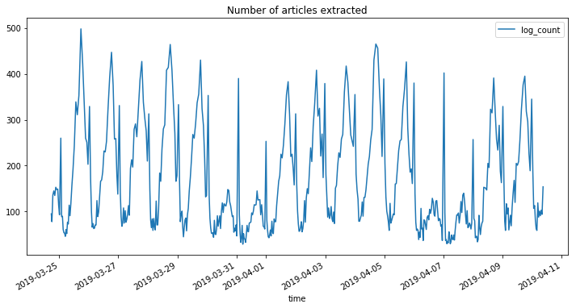
Web Scrapping
Dataset with over 70.000 news articles

Slide 11
Web Scrapping
Dataset with over 70.000 news articles
Scraped over 19 newspaper for 2 weeks

Slide 12
Web Scrapping
Dataset with over 70.000 news articles
Scraped over 19 newspaper for 2 weeks
With an average of 3.600 news articles per newspaper

Slide 13

LDA Analysis
Aims to detect topics within the articles

Slide 14
LDA Analysis
Aims to detect topics within the articles
Model hyperparameters were trained (#Topics, Alpha, Eta) -> measured based on coherence score

Slide 15
LDA Analysis
Aims to detect topics within the articles
Model hyperparameters were trained (#Topics, Alpha, Eta) -> measured based on coherence score
Result was analysed based on its assessment

Slide 16
LDA Analysis
Aims to detect topics within the articles
Model hyperparameters were trained (#Topics, Alpha, Eta) -> measured based on coherence score
Result was analysed based on its assessment
0.033*"border" + 0.016*"mexico" + 0.016*"trump"
+ 0.010*"immigration" + 0.008*"states" + 0.008*"united"
+ 0.008*"president" + 0.007*"illegal" + 0.007*"migrants"
+ 0.006*"people"
Figure 1: Example Topic for keyword "Trump"

Slide 17
Sentiment Analysis
Search for polarity in newspaper articles

Slide 18
Sentiment Analysis
Search for polarity in newspaper articles
Quantifying polarity with a word dictionary -> score for each article

Slide 19
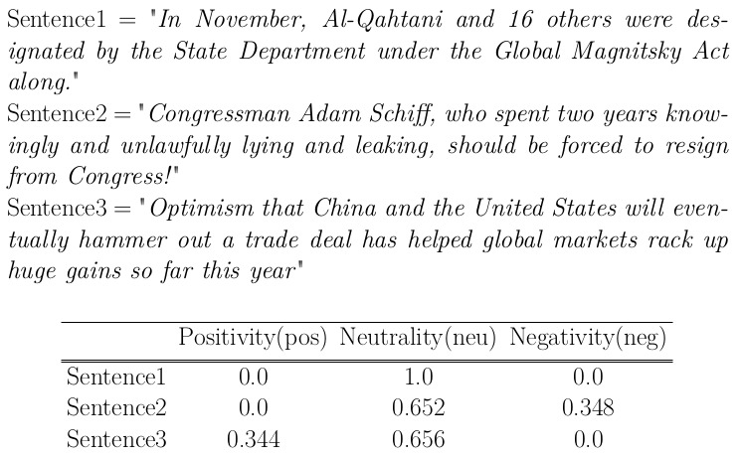
Sentiment Analysis
Search for polarity in newspaper articles
Quantifying polarity with a word dictionary -> score for each article
Figure 2: Example Sentiments

Slide 20
Future Work
Increase the number of newspapers and find a method to select the same number of articles for each one

Slide 21
Future Work
Increase the number of newspapers and find a method to select the same number of articles for each one
Extrapolate the work to different regions and languages

Slide 22
Future Work
Increase the number of newspapers and find a method to select the same number of articles for each one
Extrapolate the work to different regions and languages
Automate topic detection

Slide 23
Future Work
Increase the number of newspapers and find a method to select the same number of articles for each one
Extrapolate the work to different regions and languages
Automate topic detection
Build a ML/Rule based algorithm to flag possible high bias on articles

Slide 24
Future Work
Increase the number of newspapers and find a method to select the same number of articles for each one
Extrapolate the work to different regions and languages
Automate topic detection
Build a ML/Rule based algorithm to flag possible high bias on articles
Apply sliding window mechanisms to track changes in sentiment towards selected topics
https://github.com/morten-novaims/Proposal_Framework_Bias_Detection

